Slide 1

FOOD IN THE LIFE OF MAN

Slide 2

TO SATISFY HUNGER

Slide 3
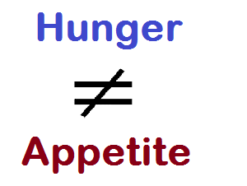
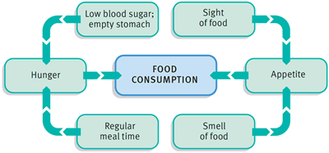
HUNGER VS APPETITE

Slide 4
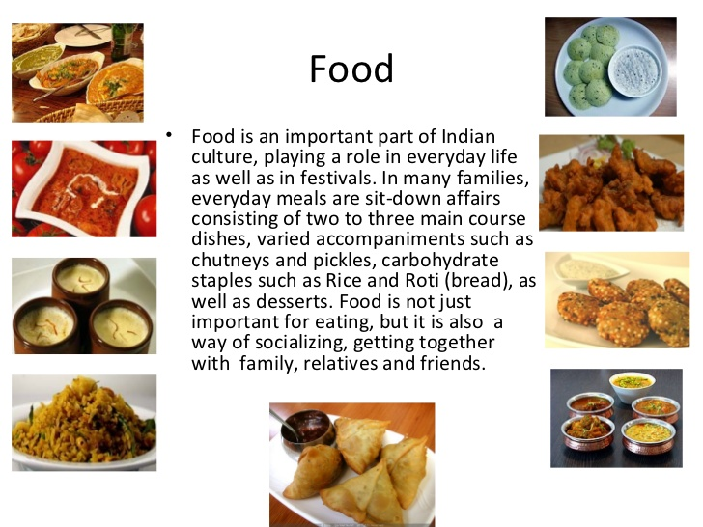
TO SATISFY CERTAIN SOCIAL NEEDS

Slide 5

FOODWAYS OF MAN

Slide 6

TO ACHIEVE CERTAIN PSYCHOLOGICAL NEEDS

Slide 7
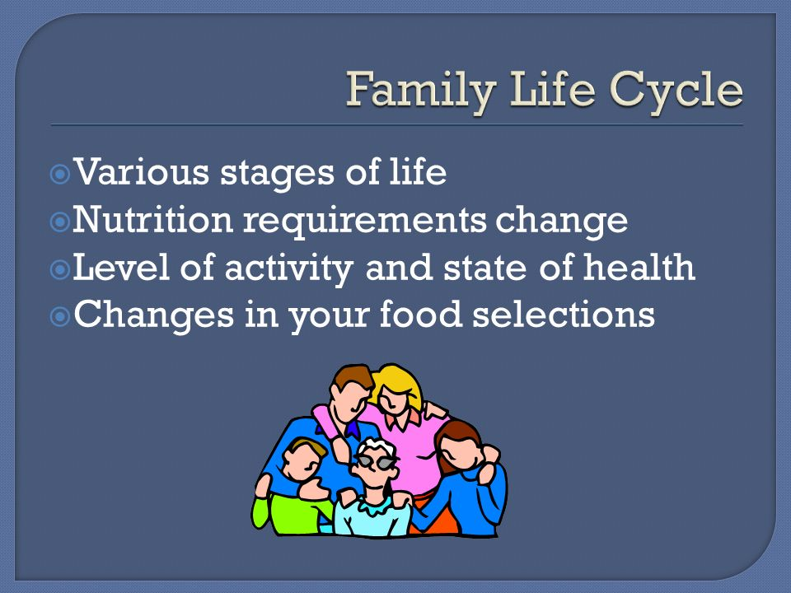
FOOD - CHANGING NEEDS WITH THE LIFE CYLE

Slide 8
FOOD JUSTICE
AFFORDABLE
ACCESSIBLE
HEALTHY
SUSTAINABLE

Slide 9

RECOMMENDED DIETARY ALLOWANCES

Slide 10
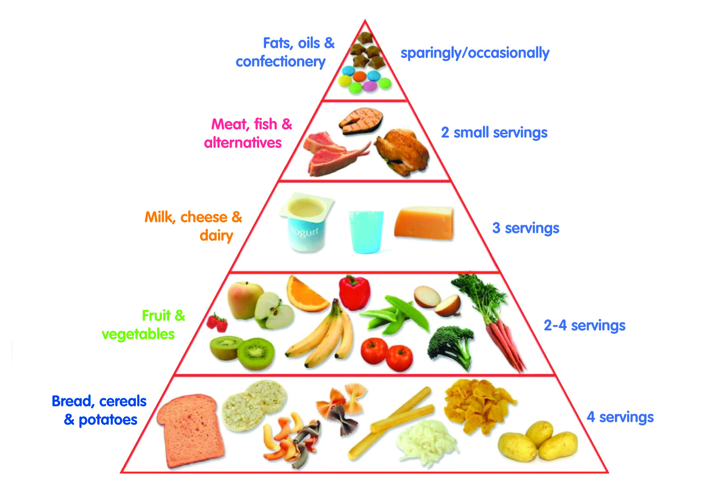
TO NOURISH THE BODY

Slide 11
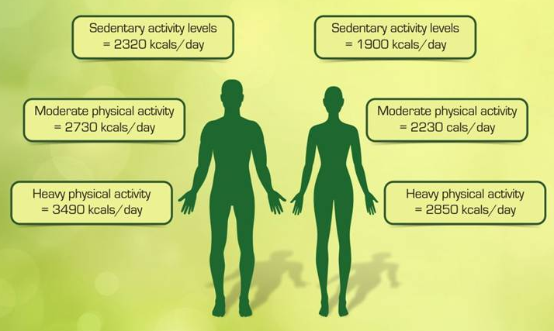
RECOMMENDED DIETARY ALLOWANCES

Slide 12
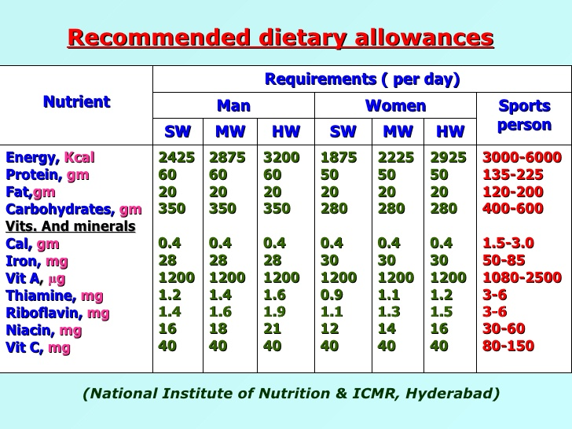
RECOMMENDED DIETARY ALLOWANCES

